Slide 1
Mapping HI absorption at z=0.026 against a resolved background CSO
Andy Biggs, Martin Zwaan, Jochen Liske
European Southern Observatory
Frank Briggs
Australian National University

Slide 2
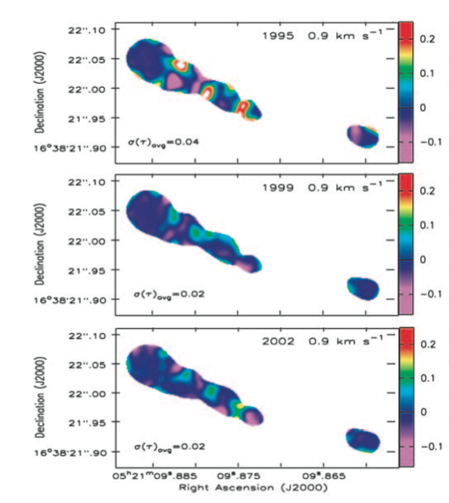
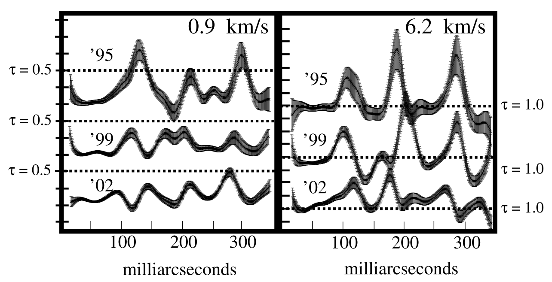
ISM absorption studies using HI
HI absorption is a powerful probe of the ISM
  Distance-independent
  Unaffected by dust
  Reservoir for the cold molecular gas from which stars will form
Scales down to several AU can be probed in the Milky Way
  e.g. 3C138 (Brogan et al. 2005)

Slide 3
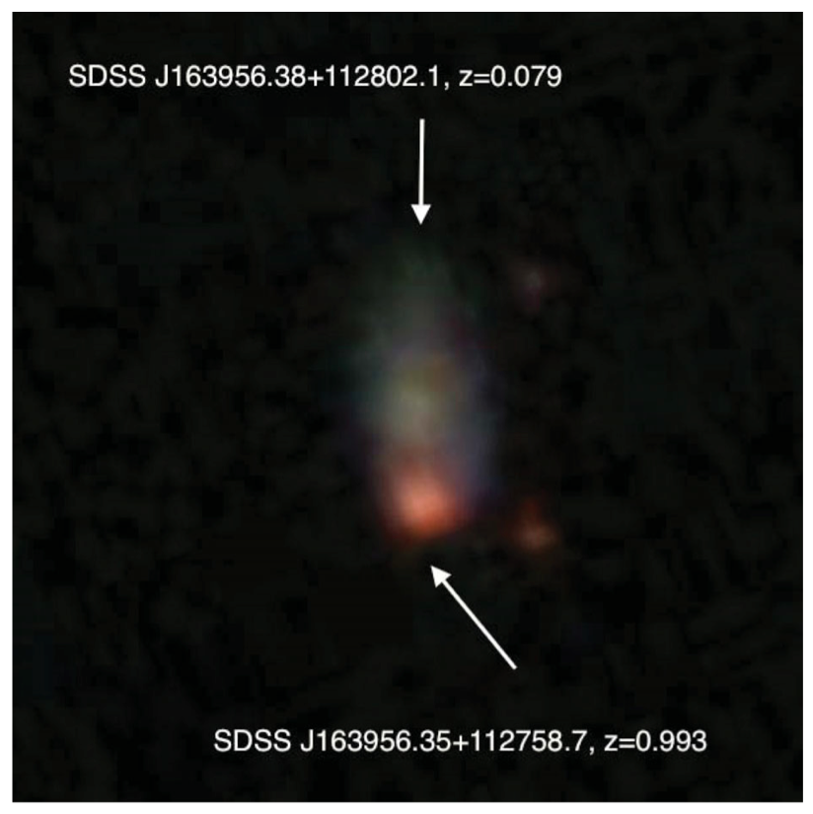
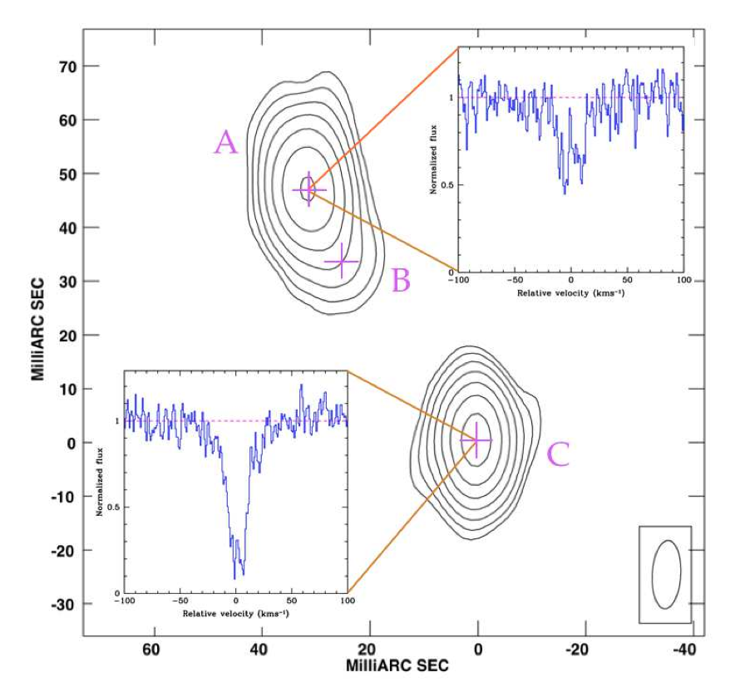
ISM of external galaxies with VLBI
(foreground absorber)
Srianand et al. (2003)
(background quasar)
VLBA HI spectrum shows significant differences between components separated by ≈ 90 pc
Gupta et al. (2012) conclude that the cold absorbing gas is patchy on scales of 30-100 pc

Slide 4
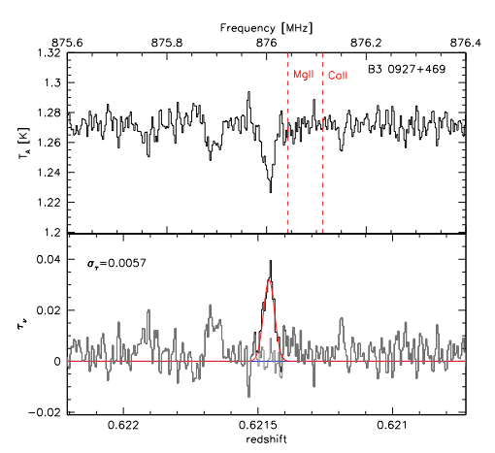
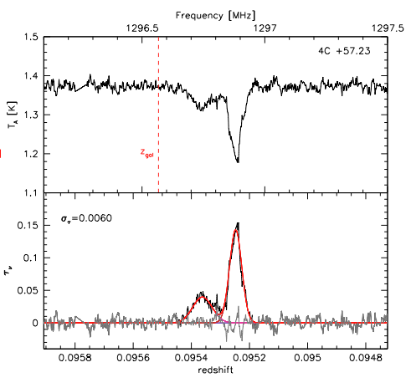
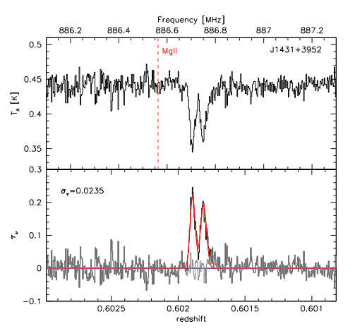
GBT HI Survey
Small impact parameter radio-loud quasar-galaxy pairs
  Select candidates from MgII, CaII, Ly-α absorbers, SDSS
  Cross correlate with FIRST sources (S_{1.4GHz} > 200 mJy and r < x”)
4 out of 24 candidates detected in HI
  At least 5 lost due to RFI
Zwaan et al. (in preparation)

Slide 5
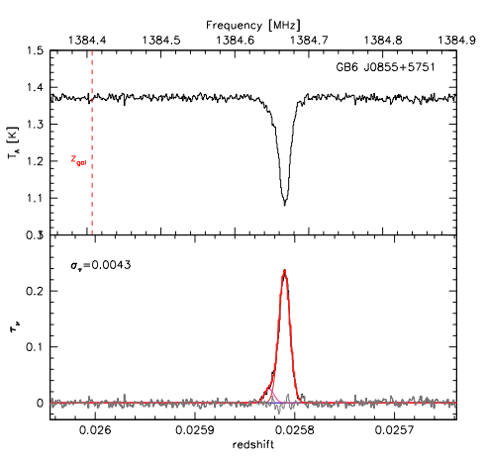
J0855+5751 GBT HI spectrum
z_{HI} = 0.02581
Two components with σ = 1.5 km/s separated by ≈ 4 km/s

Slide 6
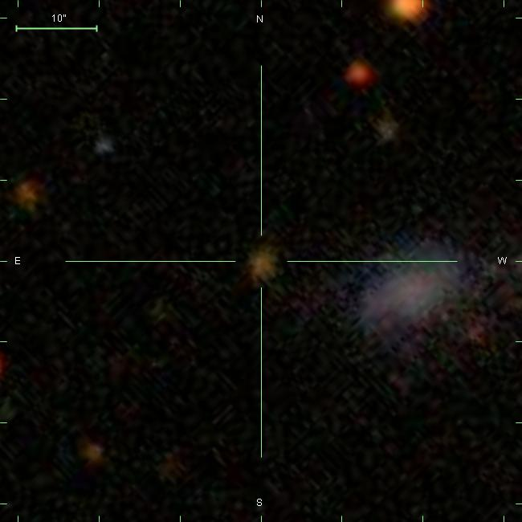
SDSS image
J0855+5751
SDSS J085519.05+575140.7
Impact parameter ≈ 7 kpc

Slide 7
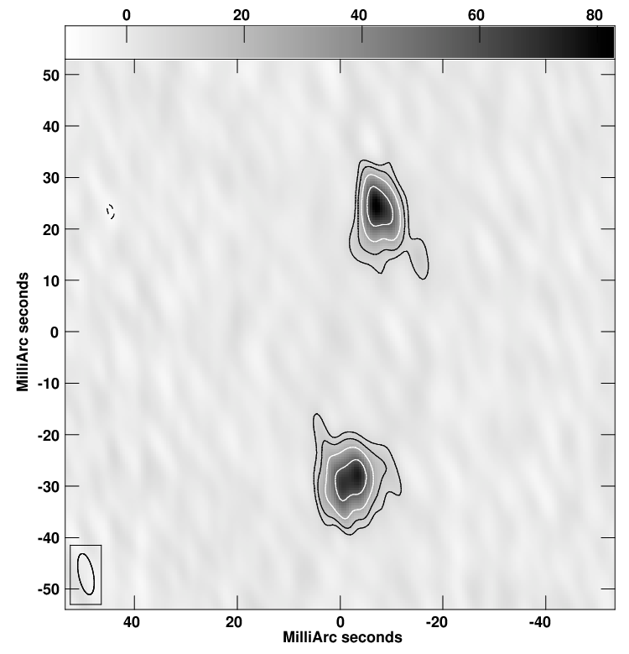
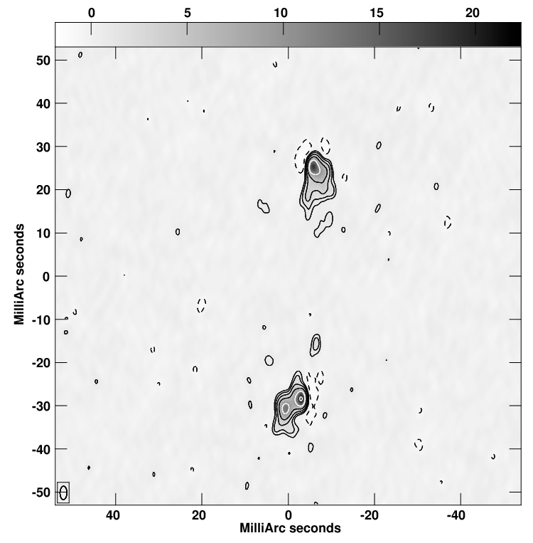
Previous VLBI observations
2.3 GHz
5 GHz
Radio core?
VLBA Calibrator Survey
(Beasley et al. 2002)
VLBA Imaging and Polarimetry Survey
(Helmboldt et al. 2007)

Slide 8
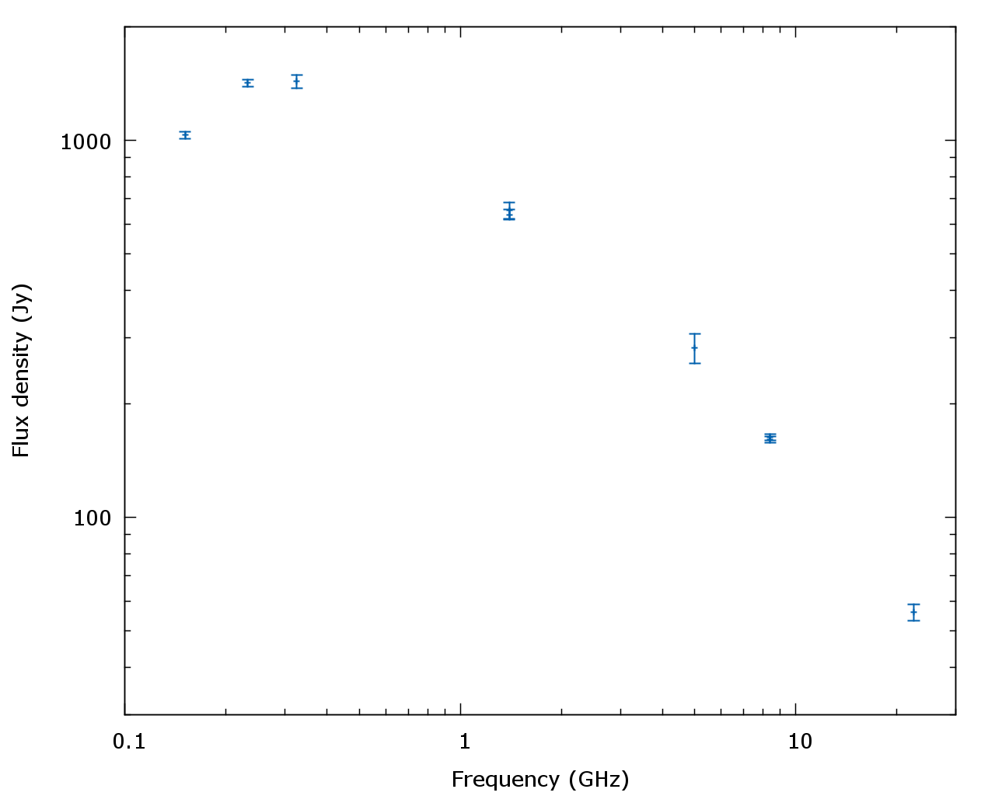
J0855+5751 properties
No spectroscopic redshift
  Sloan photometric z ≈ 0.34
P_{125MHz} > 2.5e25 W/Hz/sr
  Assuming z=0.1
Projected size < 0.5 kpc
  Assuming 70 mas at z=1
Radio SED peak ≈ 300 MHz
Unpolarized
J0855+5751 fulfils many criteria of CSS/GPS sources
Taylor et al. (2005) previously identified J0855+5751 as a Compact Symmetric Object

Slide 9
New global VLBI observations
Jb1, Ef, Wb (phased array), Mc, Tr, Bd, Zc + VLBA
  Angular resolution@ 1385 MHz = 4 mas
  4 mas = 2 pc @ z = 0.026
In-beam phase calibrator!
  J0854+5757 = 0850+581
  8’ from target (not usable for Wb)
Used 4 x 2 MHz subbands
  Continuum sensitivity = 15 μJy/beam
One subband for HI line
  Spectral resolution = 200 m/s
  Sensitivity of 1.4 mJy/channel
Goal was to investigate ISM on scales between 2-30 pc

Slide 10
Continuum image
Core component seen
in 5-GHz map
C-band peak flux = 2.1 mJy/beam
L-band peak flux = 3.4 mJy/beam
α ≈ -0.4
Distorted lobe with deflected jet
Interaction with ISM of host galaxy

Slide 11
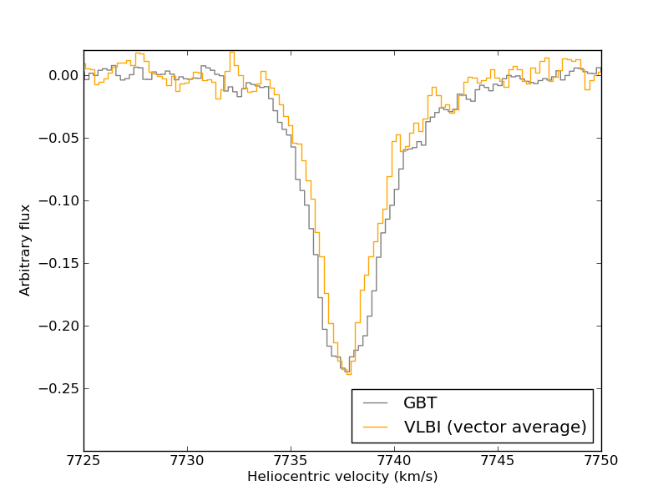
Comparison with GBT spectrum

Slide 12
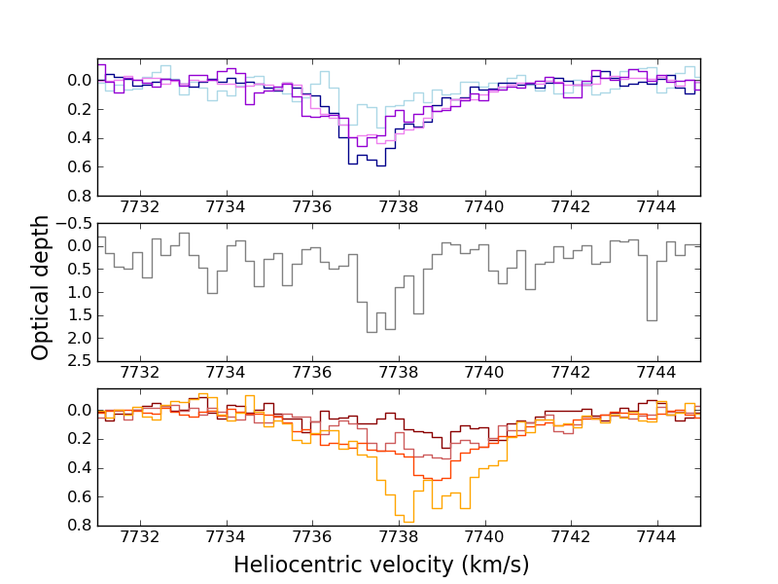
Individual VLBI spectra
North lobe
Core
South lobe

Slide 13
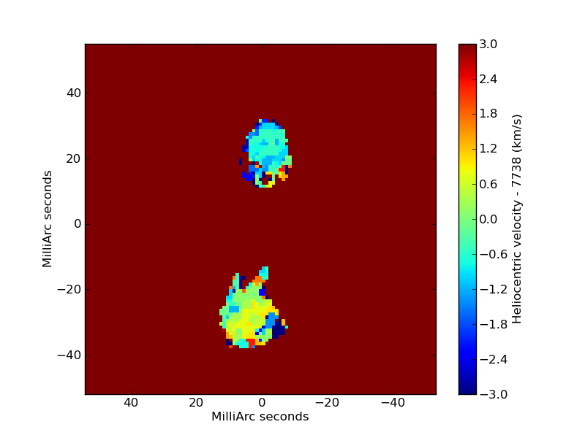

Slide 14
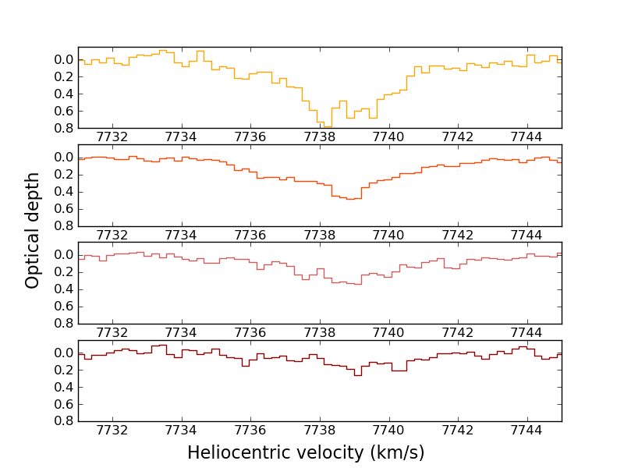
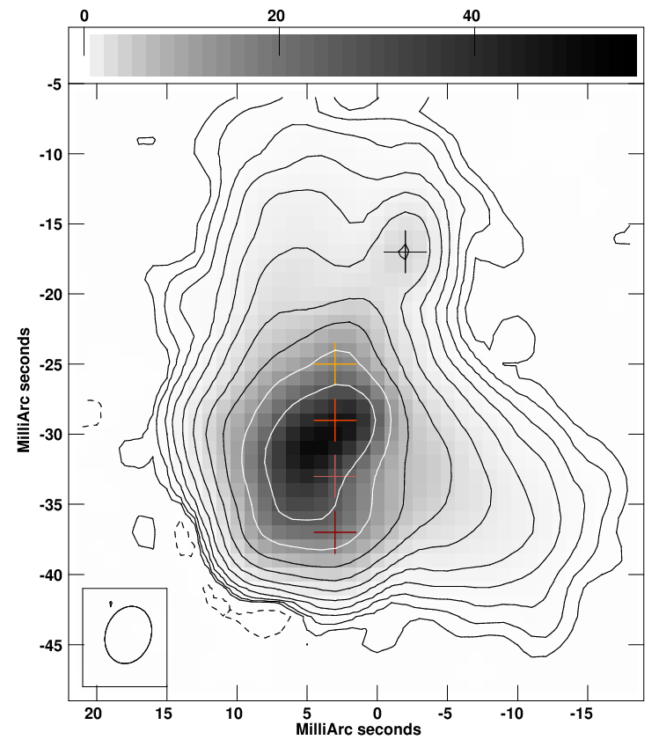
South lobe

Slide 15
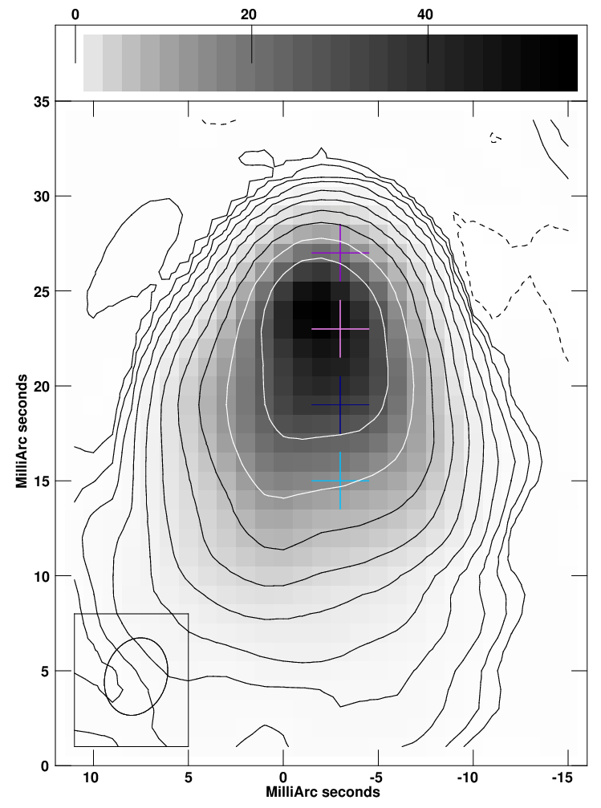
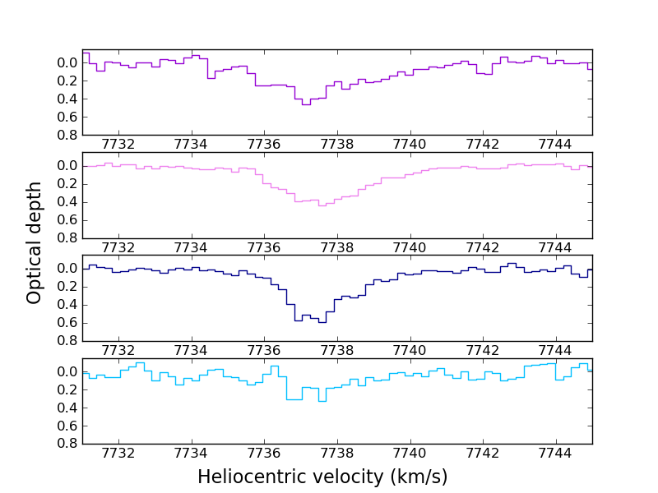
North lobe

Slide 16
Summary
We have obtained multiple independent sightlines through the cold neutral gas in a galaxy at z=0.026
Foreground absorber
  Optical depths much higher than seen in single dish spectra
  Velocity offset between absorption against each lobe
  Significant variations on sightlines separated by a few pc
Background radio source
  Identification as a CSO seems secure
  Radio source is strongly interacting with ISM of host galaxy

